Slide 1

Air Quality and Economic Progress in India
Zhima’s House - Midterm Presentation
Rui Lin, Deyao Kong, Zihao Xu, Lizhou Wang, Shan Wu, Junhao Xiang

Slide 2
CONTENTS
01
02
03
04
Project Vision & Goals
Exploratory Data Analysis
Data Acquisition & Processing
Statistical Analysis & Model

Slide 3
01
Project Vision
Find the relationship between the changes in air quality and the changes in economic outcomes in more than 50 cities across India
Help researchers model trade-offs involved in achieving various sustainable development goals(SDG)

Slide 4
Project Goals
Filling Missing Value
Economic Model
Backfilling the air quality data from 2018 to 2020 and merging data sets & Creating visualization dashboard
Estimating the relationship between changes in unemployment rate and changes in emissions
Fetching Data
Emission Model
Getting high quality time-series data for big polluting gasses from Openweathermap.org API and imputing missing values
Estimating the emissions history which is the relationship between economic changes and air quality by city

Slide 5
Project Timeline
Milestone 1 10/02
Created Project Charter and presented to sponsor
Milestone 2 10/07
Connected to API and created exploration visualization and presented to sponsor
Milestone 3 10/21
Generated an estimate of the OpenWeatherMap data from 2018-2020
Milestone 4 11/18
Found the relationship between changes in emissions and economic growth
Milestone 5 11/27
Milestone 6 12/05
Created dynamic visualization (dashboard)
Completed Final Presentation
Milestone 1 10/02
Created Project Charter and presented to sponsor
Milestone 2 10/07
Connected to API and created exploration visualization and presented to sponsor
Milestone 3 10/21
Generated an estimate of the OpenWeatherMap data from 2018-2020
Milestone 4 11/18
Found the relationship between changes in emissions and economic growth
Milestone 5 11/27
Milestone 6 12/05
Created dynamic visualization (dashboard)
Completed Final Presentation

Slide 6
02
Exploratory Data Analysis

Slide 7
Data Sources
O
OpenWeatherMap API
G
Government Data
O
G
The pollution data from Indian government
Some missing values
Split in stations
Data from the OpenWeatherMap, used as a ground truth for air pollution
No missing values
Split in cities
S
T
S
Satellite Data
T
Transportation Data
Data from NASA satellites about air pollution
A lot of missing values
Split in cities
Under discover

Slide 8

Data Sources
O
OpenWeatherMap API
Data from the OpenWeatherMap, used as a ground truth for air pollution
No missing values
Split in cities
Delhi API
City | Lat | Lng | Date | CO | NO2 | SO2 | PM2_5
Delhi | 28.564 | 77.145 | 2020/11/24 | 3831.862 | 92.7075 | 59.9625 | 426.015
Delhi | 28.564 | 77.145 | 2020/11/25 | 2827.724 | 85.68167 | 81.34042 | 318.5196
Delhi | 28.564 | 77.145 | 2020/11/26 | 1978.796 | 63.53375 | 61.28417 | 137.8254
Delhi | 28.564 | 77.145 | 2020/11/27 | 1642.783 | 55.17958 | 39.54792 | 133.6429
Delhi | 28.564 | 77.145 | 2020/11/28 | 2540.668 | 73.03083 | 41.565 | 198.6775
“Сurrent Weather and Forecast - OpenWeatherMap.” Сurrent Weather and Forecast - OpenWeatherMap, openweathermap.org. Accessed 30 Oct. 2022.

Slide 9
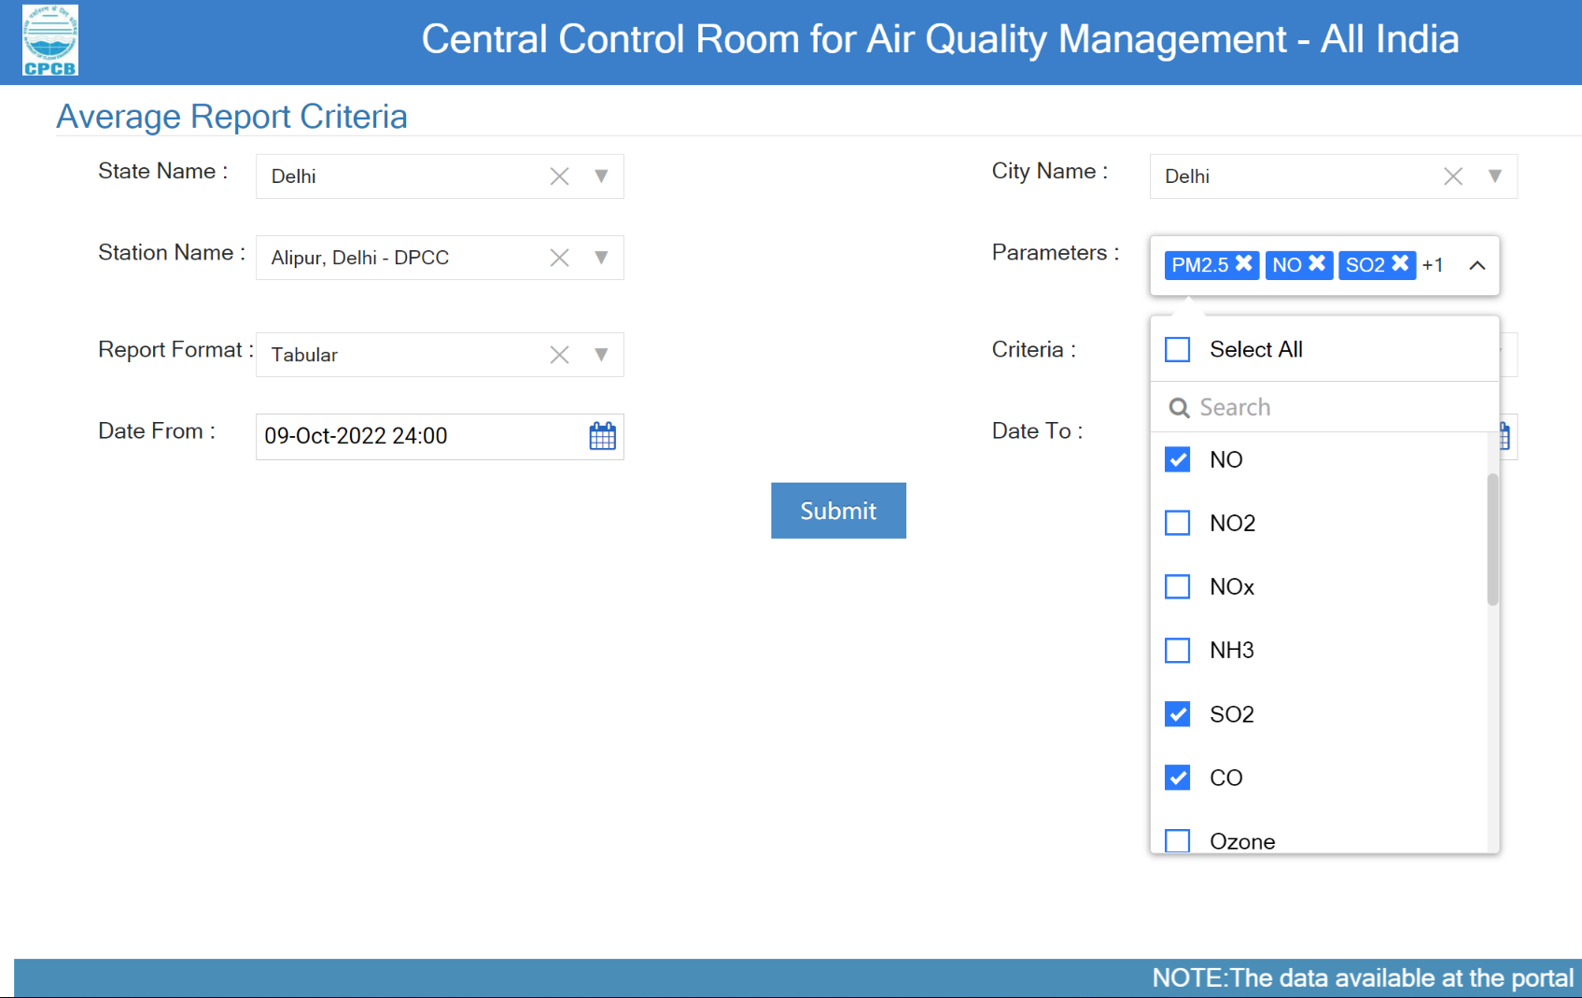
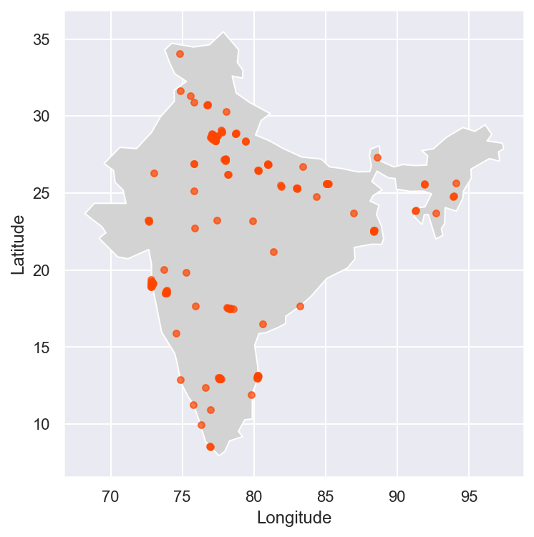
Data Sources
City
Station 1
File 1
File 2
Station 2
File 1
G
Government Data
The pollution data from Indian government
Some missing values
Split in stations
From_Date | To_Date | PM2.5 | SO2 | NO2 | CO
01-01-2018 00:00 | 02-01-2018 00:00 | 488.62 |  | 87.65
02-01-2018 00:00 | 03-01-2018 00:00 | 360.76 |  | 83.98
03-01-2018 00:00 | 04-01-2018 00:00 | 288.57 |  | 87.43
04-01-2018 00:00 | 05-01-2018 00:00 | 352.22 |  | 92.08
05-01-2018 00:00 | 06-01-2018 00:00 | 305.94 |  | 82.24
“Central Control Room for Air Quality Management - All India.” CCR, https://app.cpcbccr.com/ccr/#/caaqm-dashboard-all/caaqm-landing/data.

Slide 10
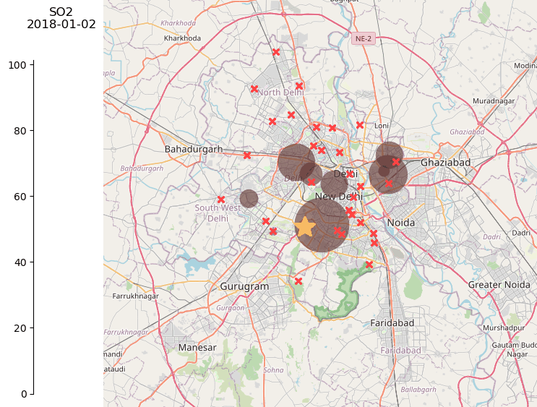
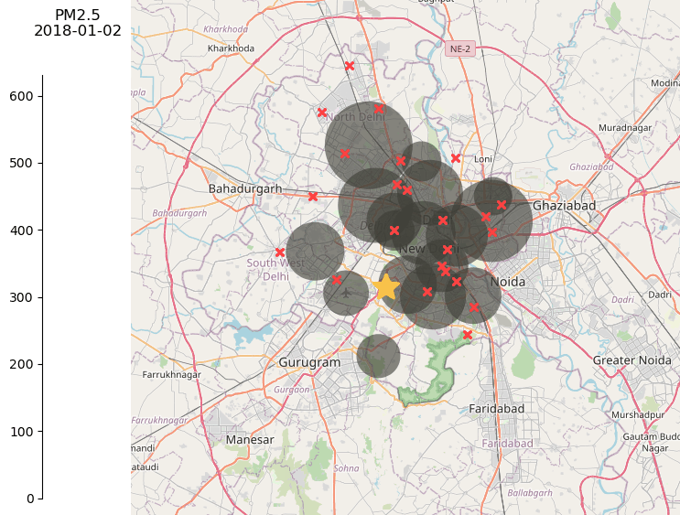
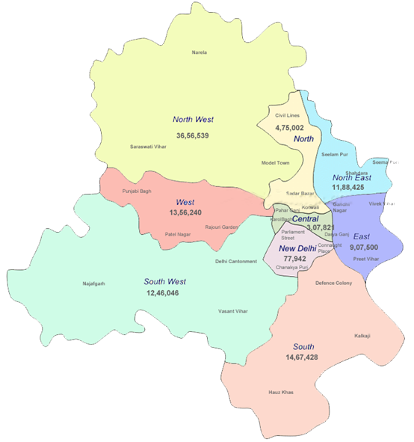
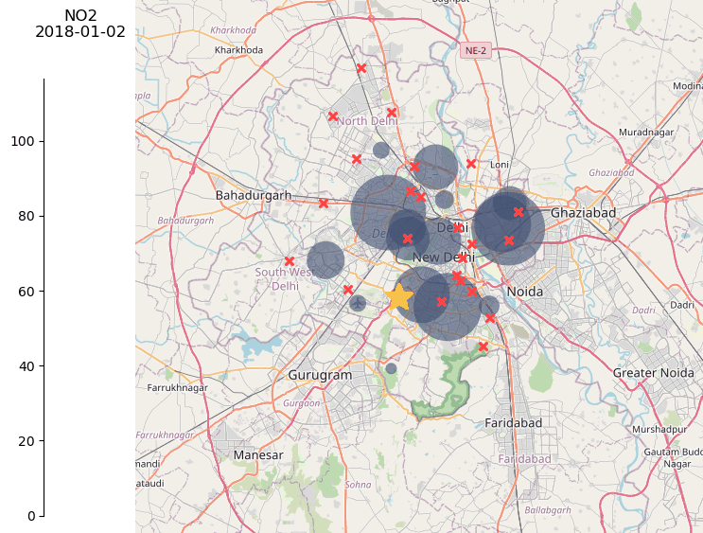
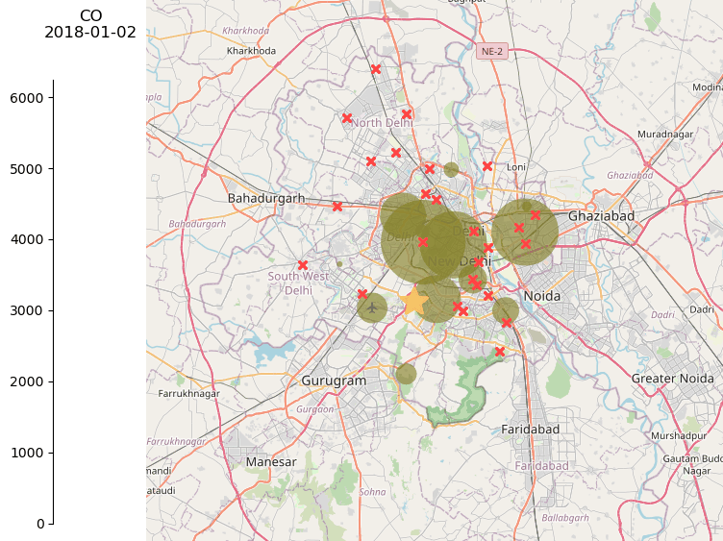
Data Sources
G
Government Data
The pollution data from Indian government
Some missing values
Split in stations
“Central Control Room for Air Quality Management - All India.” CCR, https://app.cpcbccr.com/ccr/#/caaqm-dashboard-all/caaqm-landing/data.

Slide 11
Data Sources
G
Government Data
The pollution data from Indian government
Some missing values
Split in stations
“Central Control Room for Air Quality Management - All India.” CCR, https://app.cpcbccr.com/ccr/#/caaqm-dashboard-all/caaqm-landing/data.

Slide 12
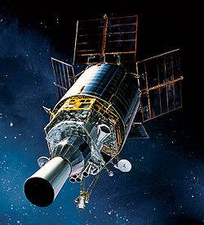
Data Sources
S
Satellite Data
Data from NASA satellites about air pollution
A lot of missing values
Split in cities
date | Agartala | Agra | Aizwal | Amritsar | Asansol | Aurangabad | …
10/1/2004 | 3.18E+15 | 5.02E+15 | 2.06E+15 | -1.27E+30 | 7.66E+15 | 4.72E+15 | …
10/2/2004 | 3.42E+15 | 5.33E+15 | 2.60E+15 | -1.27E+30 | 5.21E+15 | -1.27E+30 | …
10/4/2004 | 3.13E+15 | 2.89E+15 | 2.23E+15 | 5.24E+15 | -1.27E+30 | 3.94E+15 | …
10/5/2004 | -1.27E+30 | 4.74E+15 | -1.27E+30 | 7.57E+15 | -1.27E+30 | 3.45E+15 | …
10/7/2004 | -1.27E+30 | 5.43E+15 | -1.27E+30 | 7.92E+15 | -1.27E+30 | 3.44E+15 | …
“Satellite - Wikipedia.” Satellite - Wikipedia, 21 Nov. 2008, en.wikipedia.org/wiki/Satellite.

Slide 13
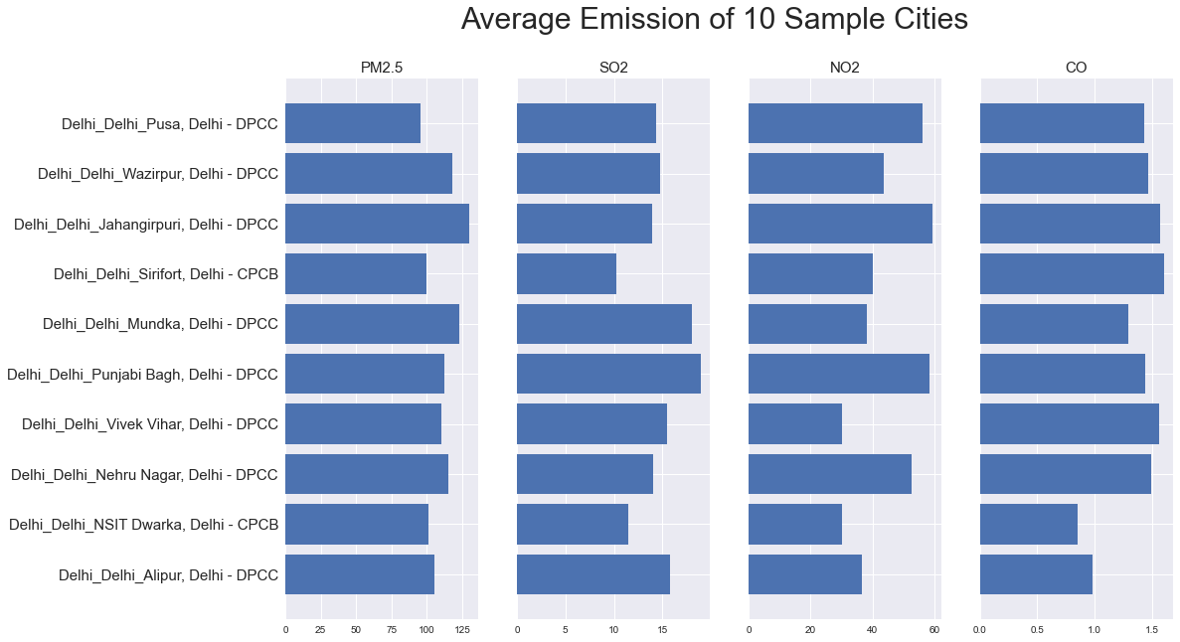
EDA

Slide 14
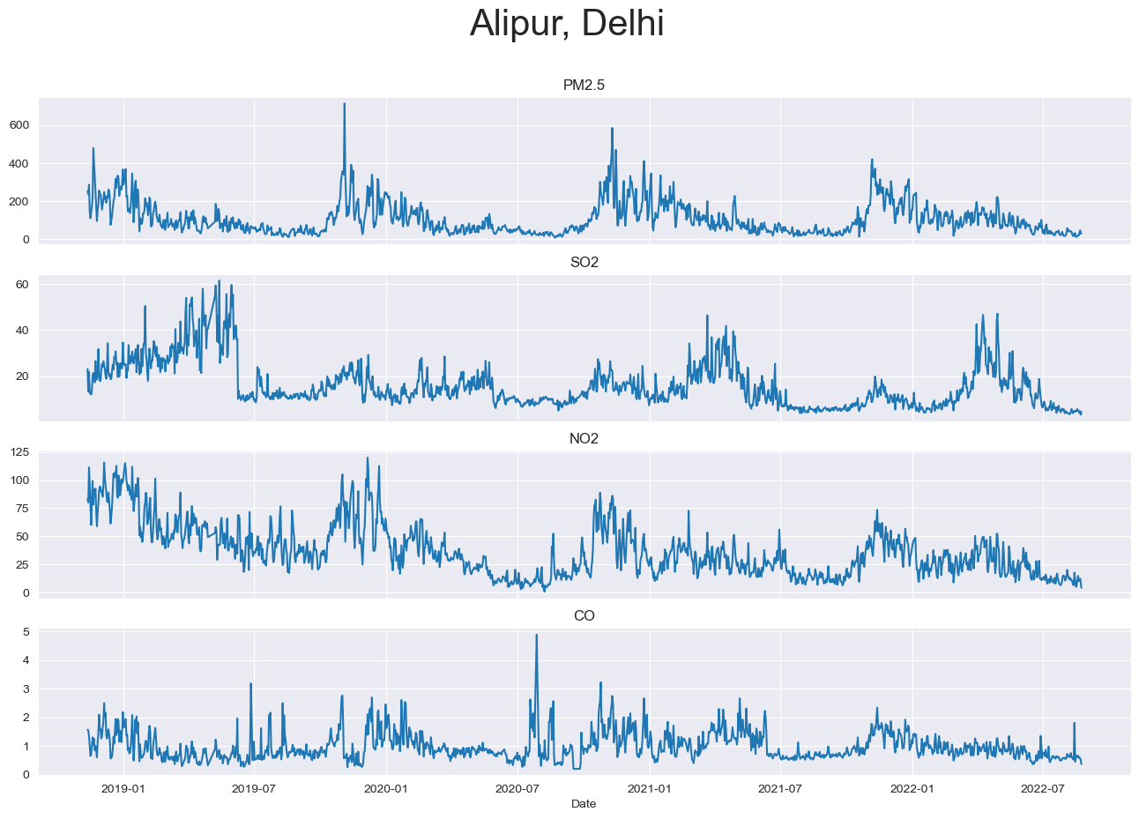
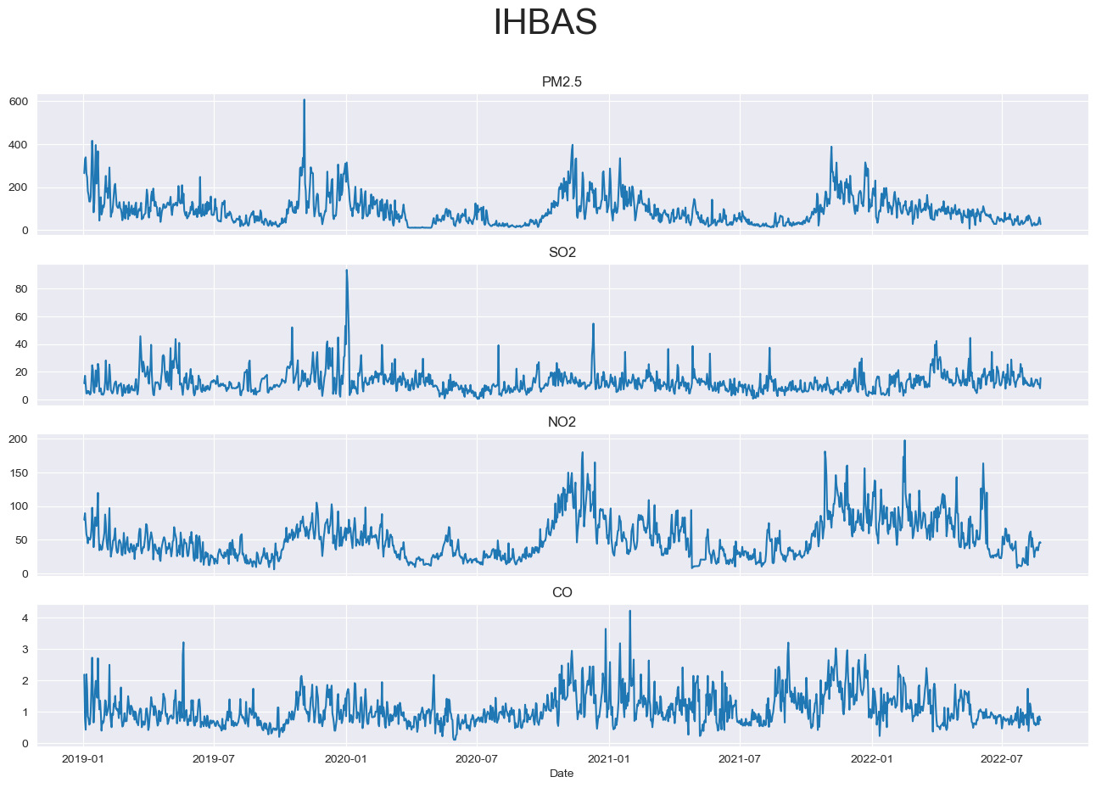
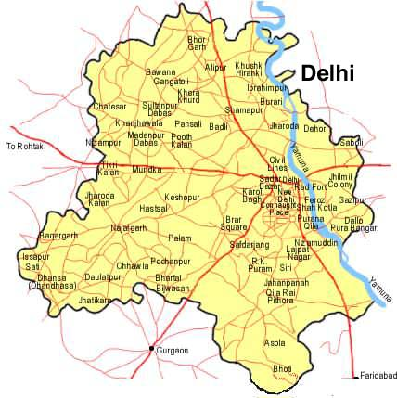
EDA

Slide 15
03
Data Processing
Fetching data from Openweathermap.org
Fetching data from Official government source
Merging official air pollution datasets by city

Slide 16
Data Acquisition
Current Challenges
Official Air Quality Data
Large gaps of missing value
CO, NO2, SO2, PM2.5 data
Cross Section
Some cities have a lot stations.
Need to find a reasonable way to measure air pollution of the whole city based on several factors
Population density, factory locations, etc
Traffic Data
Missing Traffic Data
Find other source of traffic and way to joining datasets together.
Fill Missing Data
Both Satellite Data and Gov Data have a large number of missing values
Satellite Data
API Air Quality Data
Large gaps of missing value
CO, NO2, SO2, PM2.5 data
Validation data
Data
Weather Data
Unemployment Data
54 main Indian cities’ general weather data
Each month unemployment rate and employed population
Transport Data
Missing

Slide 17
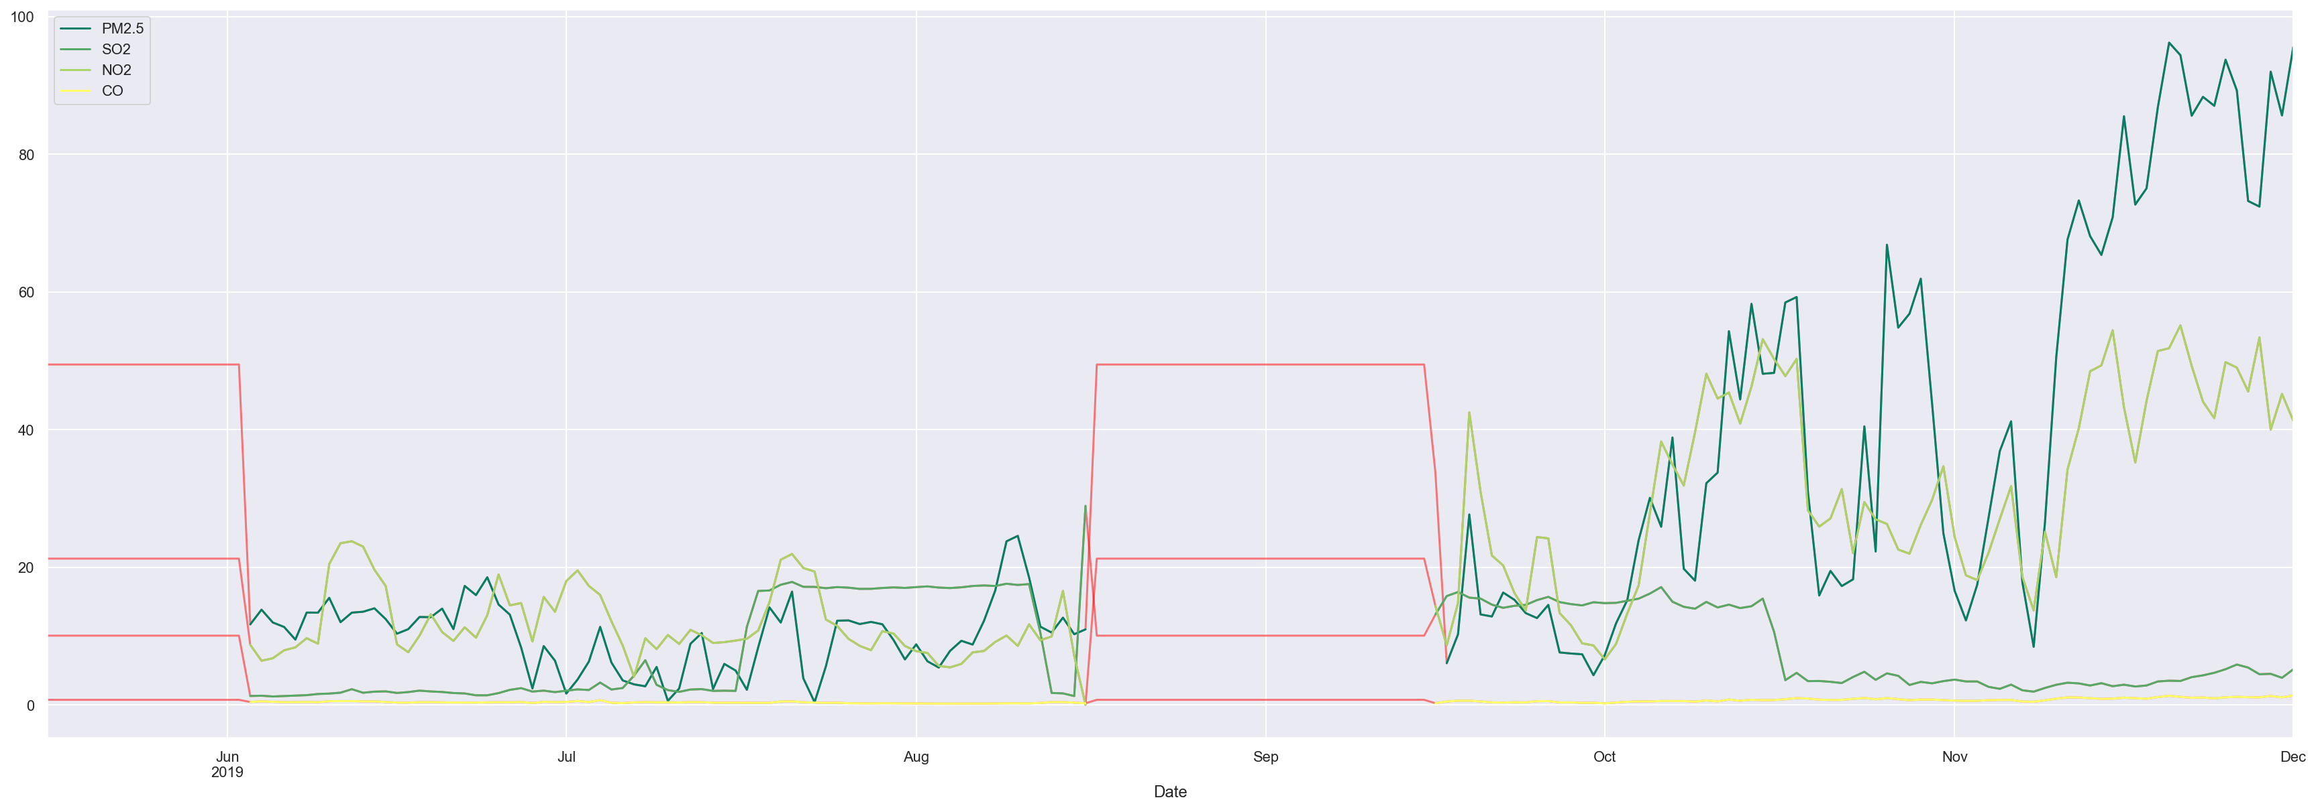
Filling Missing Value
k-Nearest Neighbor Imputation
Each sample’s missing values are imputed using the mean value from n_neighbors nearest neighbors found in the training set. Two samples are close if the features that neither is missing are close.
Disadvantages of KNN
Does not work well with large dataset
Need feature scaling
Sensitive to noisy data, missing values and outliers
Kumar, Naresh. “Advantages and Disadvantages of KNN Algorithm in Machine Learning.” Advantages and Disadvantages of KNN Algorithm in Machine Learning, http://theprofessionalspoint.blogspot.com/2019/02/advantages-and-disadvantages-of-knn.html.
Notes:
Thanks for Lizhou’s introduction of our data source. As he mentioned our datasets contain lots of missing value. These can significantly influence us to build model especially for timeseries data. Here is an example that we use the k-nearest neighbor imputation, one of the most common method to fill the missing value for timeseries data. We can see that for large gaps of missing value this approach can only fill with horizontal lines. This would perform worse for more missing values. At this point we have to create our own methods for filling missing value.

Slide 18
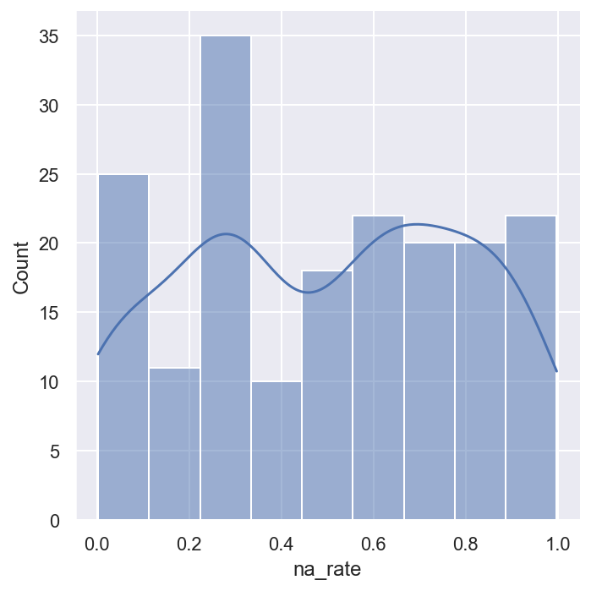
Filling Missing Value
Fill full records by KNN-interpolation for stations with NA percentage less than 0.02
Need to use good stations’ records to fill the rest stations with high NA percentage
Two ways of filling
Use the nearest good station to fill
Use the best station in the same cluster to fill
Notes:
First of all, we check the distribution of the proportion of missing value in the 183 stations’ air quality data. From this plot, we can see that most of them will have large gaps of missing value. We find that it is good to use knn interpolation for data contains less than 2% missing value. Then, we generated two ways to fill the rest of the missing value based on those completed datasets. One is filling by the nearest station data. For our common sense, it is reasonable that close places will have similar air quality. The other one is filling missing value based on the clustering of those station data. I will mainly explained how we fill the missing value by nearest distance.

Slide 19
Filling Missing Value - by Distance
Creating Distance matrix
Using the closest station to fill missing values
Starting filling with the lowest proportion of NA station
Notes:
First, we get the coordinates of each station based on the geopy module in python. Then, create a geo-distance matrix. From the map, we can see most of the station are close to each other. We will start with the station data contains the lowest proportion of missing value. We first fill the missing value based on top 10 closest station data. If there still exists missing value. We will use the nearest completed datasets. With this method, we seemly got a pretty good result.

Slide 20
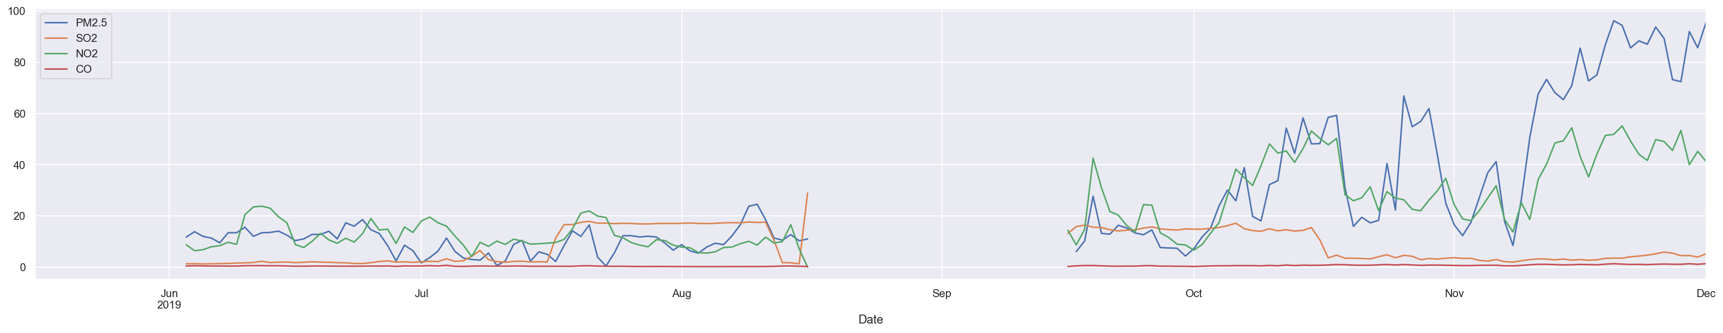
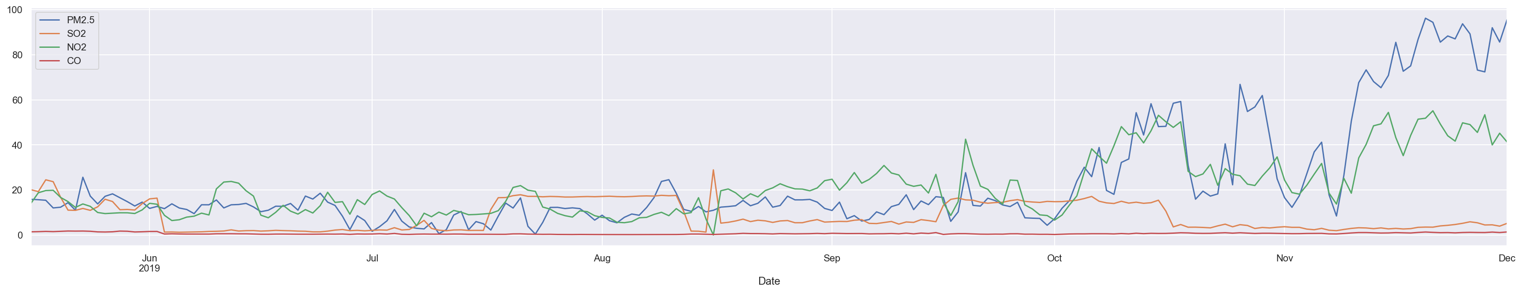
Results-Distance
Maharashtra_Mumbai_Vile Parle West, Mumbai - MPCB
Notes:
From the plot, we can see by this method we obtained a better and more reasonable filling results than our original knn approach. Although, the results look good, we still find a way to validate whether this method is acceptable to fill the missing value. We are thinking of making a hypothesis test. This we will check in our next step. Then, lets invite Ray to introduce our clustering method.

Slide 21
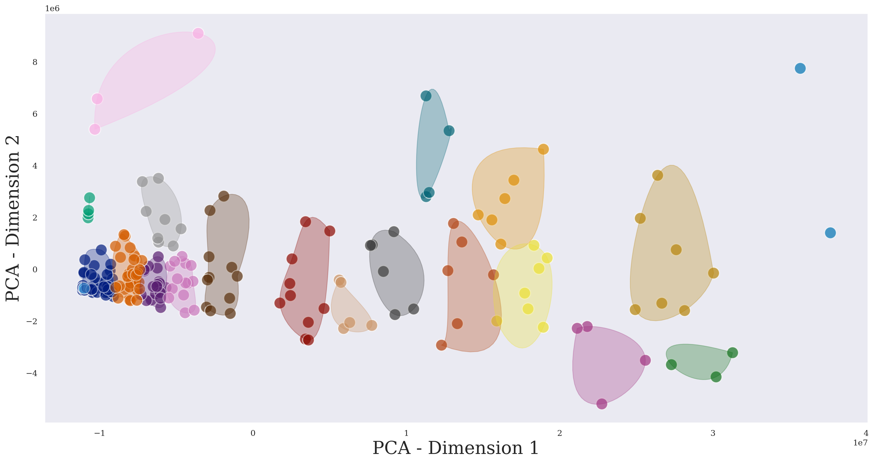
Filling Missing Value - by Cluster
Apply KNN clustering to all stations
Use the center or the “best” stations’ records to estimate missing values for other stations in the same cluster
Use the best nearest station records to fill in the rest missing values

Slide 22
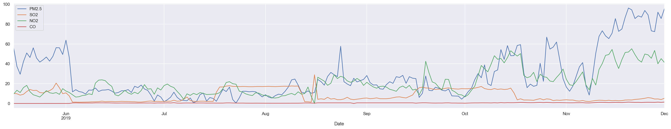
Results-Cluster
Maharashtra_Mumbai_Vile Parle West, Mumbai - MPCB

Slide 23
Results-Comparison
Pros:
All missing values are filled
Reasonable way to fill by both distance or clusters
Distance:
Cons:
Cluster:
Similarly patterns across stations in a same cluster especially for those with high NA percentage ( >80%)
Clustering results might not be accurate

Slide 24
Fill Missing Value - Satellite Data
Fill the missing value in satellite data by KNNImputer
Extract satellite data by date(2018-01-01 ~ 2021-12-31)
Replace missing value with NaN

Slide 25
City
SO2
NO2
CO
PM2.5
Data Aggregation
City
API
Gov
Satellite
Transport
Station 1
Station 2
Reason
Easier for modeling
Could improve accuracy
Challenge
City names are different among different datasets
Dates do not match among datasets
date | open_SO2 | sate_SO2 | Alipur, Delhi - DPCC | Anand Vihar, Delhi - DPCC | …
2020/11/24 | 59.9625 | -0.082 | 12.09 | 11.6 | …
2020/11/25 | 81.34042 | 0.062 | 16.48 | 7.89 | …
2020/11/26 | 61.28417 | 0.75 | 12.55 | 12.05 | …
2020/11/27 | 39.54792 | -0.114 | 18.06 | 0.72 | …
2020/11/28 | 41.565 | 0.8 | 19.28 | 1.19 | …
Result
Merge data by city
Each city have different datasets for different gases
Each station acts as a feature for corresponding cities
Delhi – SO2

Slide 26
Future Solution
Finding more comprehensive data resources or open API
Need a better feature selections for clustering
Use normalization
Use other features to represent missing feature
Applying differencing or time series smoothing techniques when building the model.
Remove seasonality and trends
Only use the residuals for inputs

Slide 27
04
Statistical Analysis & Model

Slide 28
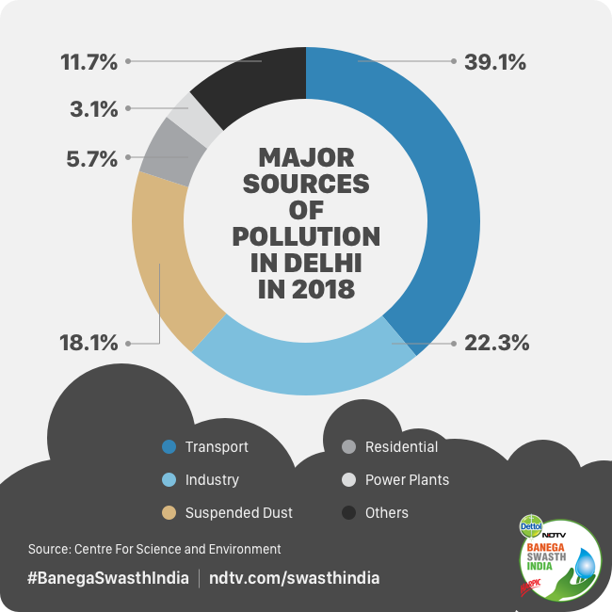

Modeling
OpenweatherMap ~ Govt.Data + NASA Data + Other Factors
Models
Ordinary Least Square
Lasso Regression
Ridge Regression
Elastic Net
Regression Tree
XGBoost
Validation
Split the data set for training and testing
Train: 70%, test: 30%
Result
Adjusted-R-squares are acceptable for most models
Regression Tree and XGBoost performs significantly worst than other models
Written By: Barkha Mathur | Edited By: Sonia Bhaskar |. “Year 2019: How Bad Is the Air We Are Breathing and What Will It Take for India to Curb Air Pollution?” NDTV, 30 Jan. 2020, https://swachhindia.ndtv.com/year-2019-how-bad-is-the-air-we-are-breathing-and-what-will-it-take-for-india-to-curb-air-pollution-40629/.

Slide 29
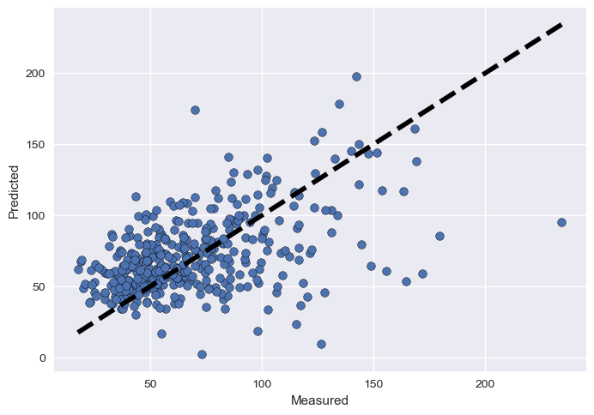
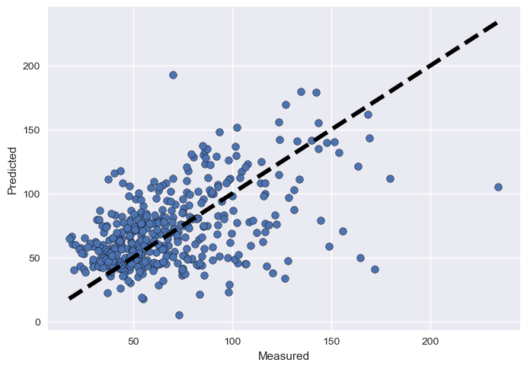

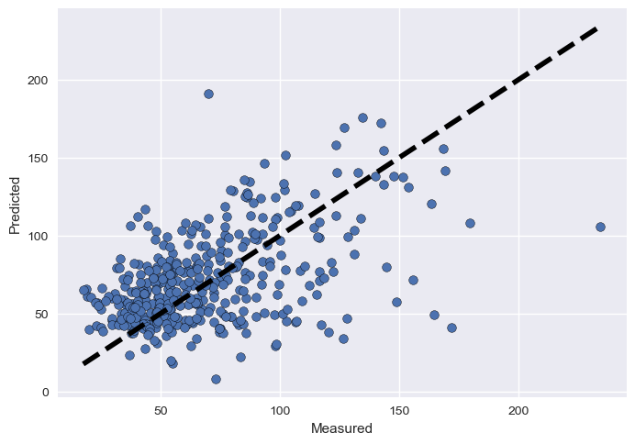
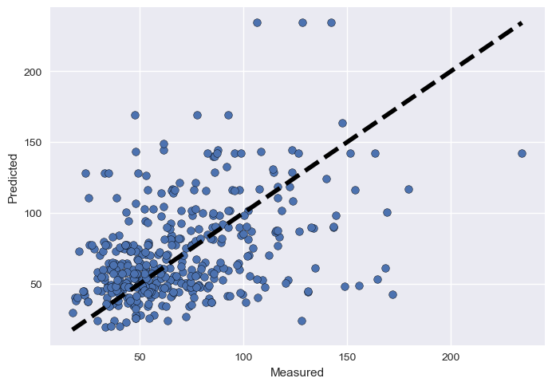
Modeling – NO2
Delhi – OLS
Delhi – LASSO
Delhi – RIDGE
Delhi – Elastic Net
Delhi – Regression Tree
Model | OLS | Lasso | Ridge | Elastic Net | Regression Tree
Adjusted R2 | 0.313 | 0.333 | 0.331 | 0.332 | 0.21
MAE | 18.7 | 18.1 | 18.1 | 18.0 | 23.6

Slide 30
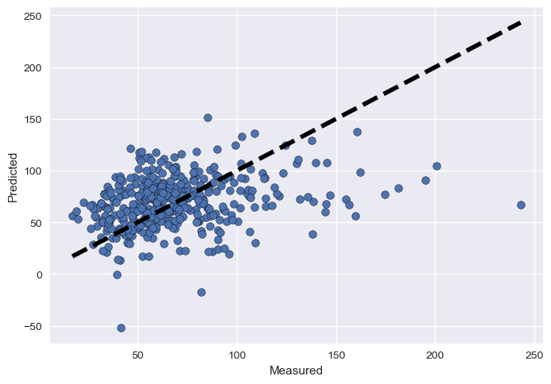
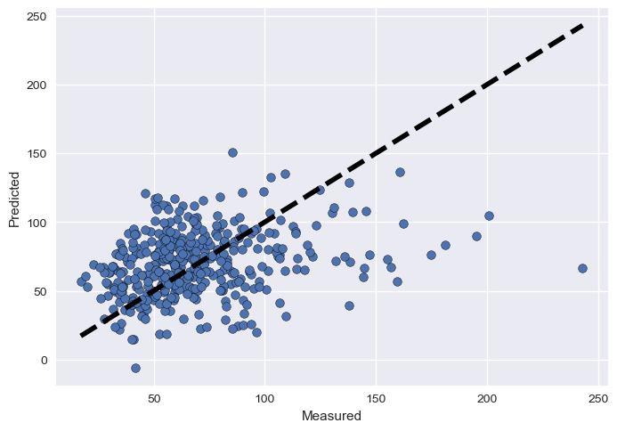
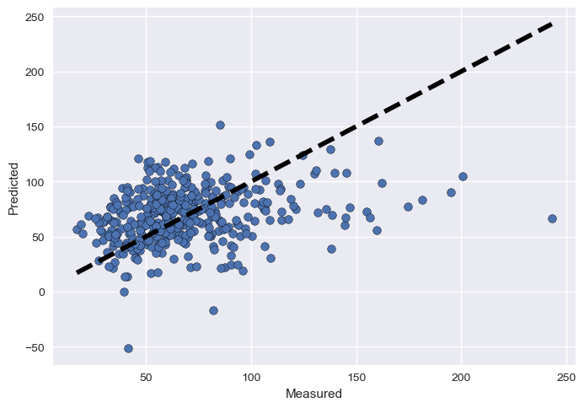
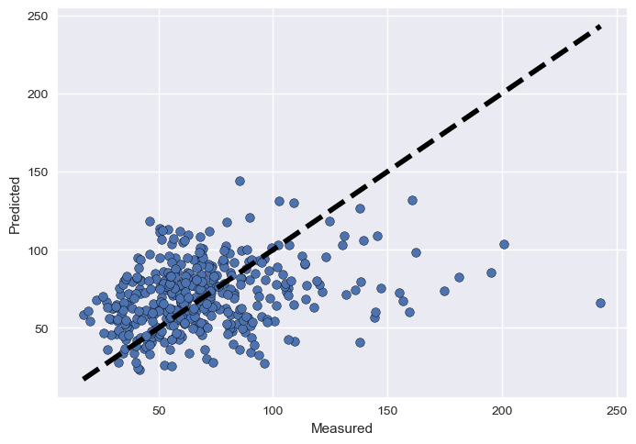
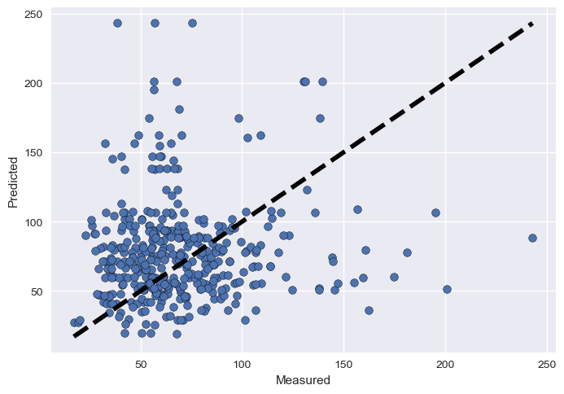
Modeling – SO2
Delhi – OLS
Delhi – LASSO
Delhi – RIDGE
Delhi – Elastic Net
Delhi – Regression Tree
Model | OLS | Lasso | Ridge | Elastic Net | Regression Tree
Adjusted R2 | 0.05 | 0.045 | 0.05 | 0.041 | 0.58
MAE | 21.0 | 20.9 | 21.0 | 20.5 | 27.9

Slide 31
Future Goal
Model Improvement
Fine tune existing model
Validate new models
Data Improvement
Economic Model
Improve feature selection
Add new features into the model( Transport, Industry, etc.)
Discover the relationship between changes in emissions and economic growth

Slide 32

Thanks for your Attention
Zhima’s House
Rui Lin, Deyao Kong, Zihao Xu, Lizhou Wang, Shan Wu, Junhao Xiang

Slide 33
Reference
“Сurrent Weather and Forecast - OpenWeatherMap.” Сurrent Weather and Forecast - OpenWeatherMap, openweathermap.org. Accessed 30 Oct. 2022.
“Satellite - Wikipedia.” Satellite - Wikipedia, 21 Nov. 2008, en.wikipedia.org/wiki/Satellite.
“Air Pollution Hot-Spot –Indian Metro cities (Delhi)” Air Pollution Hot-Spot –Indian Metro cities (Delhi), envis.tropmet.res.in/Hotspots/Airpollution_Hotspot_Delhi.html. Accessed 30 Oct. 2022.
Kumar, Naresh. “Advantages and Disadvantages of KNN Algorithm in Machine Learning.” Advantages and Disadvantages of KNN Algorithm in Machine Learning, http://theprofessionalspoint.blogspot.com/2019/02/advantages-and-disadvantages-of-knn.html.
Francis Galton. "Regression Towards Mediocrity in Hereditary Stature," Journal of the Anthropological Institute, 15:246-263 (1886)
Pedregosa, F., Profile, V., Varoquaux, G., Gramfort, A., Michel, V., Thirion, B., Grisel, O., Blondel, M., Prettenhofer, P., Weiss, R., Dubourg, V., Vanderplas, J., Passos, A., Cournapeau, D., Brucher, M., Perrot, M., Duchesnay, É., &amp; Metrics, O. M. V. A. (2011, February 1). Scikit-Learn: Machine learning in Python. The Journal of Machine Learning Research. Retrieved October 30, 2022, from https://dl.acm.org/doi/10.5555/1953048.2078195
“Central Control Room for Air Quality Management - All India.” CCR, https://app.cpcbccr.com/ccr/#/caaqm-dashboard-all/caaqm-landing/data.
Written By: Barkha Mathur | Edited By: Sonia Bhaskar |. “Year 2019: How Bad Is the Air We Are Breathing and What Will It Take for India to Curb Air Pollution?” NDTV, 30 Jan. 2020, https://swachhindia.ndtv.com/year-2019-how-bad-is-the-air-we-are-breathing-and-what-will-it-take-for-india-to-curb-air-pollution-40629/.

